Slide 1
Regression with Time Series Data
Stationary Variables
Part 1
BUAN / MECO 6312
Dr. Moran Blueshtein
University of Texas - Dallas

Slide 2
Introduction
3 important features of time-series data to consider:
Many time periods.
Time-series data have a natural ordering according to time.
There is usually dynamic relationships between variables

Slide 3
Introduction
A dynamic relationship means that a change in a variable has an impact on that same variable, or other variables, in one or more future time periods.
These effects do not occur (only) instantaneously but they are spread, or distributed, over future time periods

Slide 4
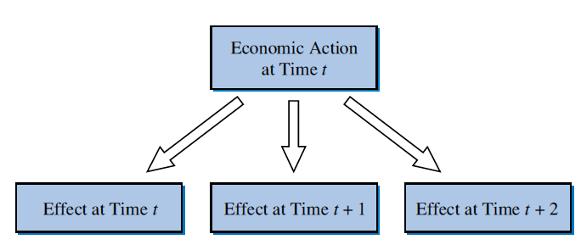
Introduction
The Distributed Lag Effect

Slide 5
Introduction
Dynamic Nature of Relationships
3 Ways to model the dynamic relationship:
Specify that a dependent variable y as a function of current and past values of an explanatory variable x
Because of the existence of these lagged effects, this is called a distributed lag model

Slide 6
Introduction
Dynamic Nature of Relationships
3 Ways to model the dynamic relationship (Continued):
Capturing the dynamic characteristics of time-series by specifying a model with a lagged dependent variables as explanatory variables.
Such models are called autoregressive models with ‘‘autoregressive’’ meaning a regression of y_{t} on its own lag or lags
Or have:
Such models are called autoregressive distributed lag (ARDL) models.

Slide 7
Introduction
Dynamic Nature of Relationships
3 Ways to model the dynamic relationship (Continued):
Capturing the continuing impact of change over several periods via the error term
In this case e_{t} is correlated with e_{t - 1}
We say the errors are serially correlated or autocorrelated.

Slide 8
Stationary and Nonstationary Variables
Stationarity
A stationary variable is one that is
Not trending,
Not wandering aimlessly without returning to its mean (random walk)

Slide 9
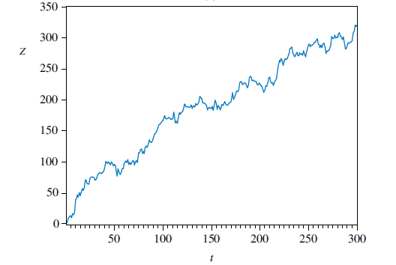
Stationary and Nonstationary Variables
Time series of a nonstationary variable: trends
Notes:
This is an example of a series of a nonstationary variable that trends.

Slide 10
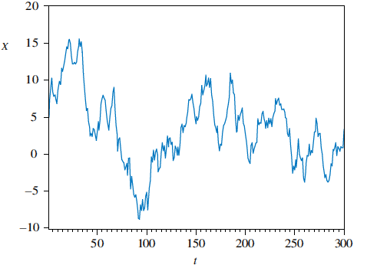
Stationary and Nonstationary Variables
Time series of a nonstationary variable: Random Walks
These time series are called random walks because they appear to wander slowly upward or downward with no real pattern
Notes:
This is an example for a time series of a nonstationary variable that is slow turning or wandering.
so sample mean taken for different periods are not the same!

Slide 11
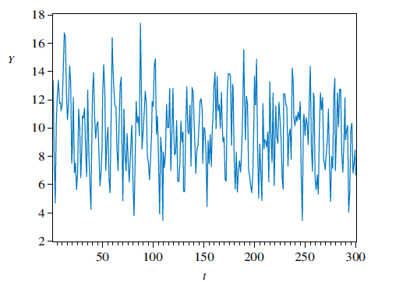
Introduction
Time series of a stationary variable

Slide 12
Stationary and Nonstationary Variables
Formally, a time series y_{t} is stationary if:
Its mean is constant over time and,
Its variance is constant over time and,
If the covariance between two values from the series depends only on the length of time separating the two values, and not on the actual times at which the variables are observed.

Slide 13
Stationary and Nonstationary Variables
That is, the time series y_{t} is stationary if for all values, and every time period, it is true that

Slide 14
Spurious Regressions
It is important to know whether a time series is stationary or non-stationary.
For example when nonstationary series are used in regression analysis there is a danger of obtaining apparently significant regression results from unrelated data (spurious regression)

Slide 15
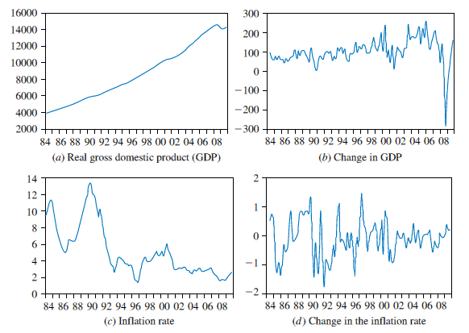
Stationary and Nonstationary Variables
Example: U.S. economic time series

Slide 16
Regression with Time Series Data
Stationary Variables
Part 2
BUAN / MECO 6312
Dr. Moran Blueshtein
University of Texas - Dallas

Slide 17
Finite Distributed Lags

Slide 18
Finite Distributed Lags
We assume a linear model in which, after q time periods, changes in x no longer have an impact on y
Note the notation change: β_{s} is used to denote the coefficient of x_{t-s} and α is introduced to denote the intercept.
It is called a finite distributed lag model of order q.

Slide 19
Multiplier Analysis
Interpretation of the Coefficients
β₀ is the impact multiplier
This is the immediate effect, or the same period effect that has on .

Slide 20
Multiplier Analysis
β_{s} is the s-period delay multiplier.
This is the effect of a change in x , s period in the past on the average value of the dependent variable in the current period.
Consequentially – this is also the effect of a change in (current value of x) on the average value of (s periods from today)

Slide 21
Multiplier Analysis
Assume x_{t} is increased by one unit and then maintained at its new level in subsequent periods (t+1), (t+2), …
The interim multiplier adds the immediate effect to subsequent delay multiplier to measure the cumulative effect.
The one period interim multiplier is the total effect at period t + 1: β₀ + β₁.
The two period interim multiplier is the total effect in period t + 2: β₀ + β₁ + β₂, and so on….
The total multiplier, , is the final effect on y of the sustained increase after q or more periods have elapsed

Slide 22
Finite Distributed Lags
Validity of OLS
If y and x are stationary random variables, and the usual assumptions hold:
1. E(e_{t}) = 0
2. var(e_{t}) = σ²
3. cov(e_{t}, e_{s}) = 0 t ≠ s
THEN OLS IS BLUE!

Slide 23
Finite Distributed Lags
An Example: Okun’s Law
Example (Okun’s Law):
Quarterly data on growth and unemployment levels from Q2, 1985 to Q3, 2009.
We want to estimate the effect of growth on unemployment.

Slide 24
Finite Distributed Lags
An Example: Okun’s Law
Example (Okun’s Law):
GDP is not stationary, but growth is
Unemployment is not stationary, but differences in unemployment is
So we use:
DU = ΔU = U_{t} - U_{t-1}

Slide 25
Finite Distributed Lags
An Example: Okun’s Law
Example (Okun’s Law):
In this model the change in the unemployment rate from one period to the next, depends on the rate of growth of output in the economy
Growth may affect change in unemployment several quarters.

Slide 26
Finite Distributed Lags
An Example: Okun’s Law
We can expand our model to include lags:
How many lags should we include?
We drop the third lag and settle on a model of order 2:
Third lag has an unexpected sign and it is not significant.
Adj R-Square is higher (and virtually no change in R-squares).

Slide 27
Estimates for Okun’s Law Finite Distributed Lag Model
Finite Distributed Lags
An Example: Okun’s Law

Slide 28
Interpretation of the Estimates
Multiplier Analysis
A 1% increase in the growth rate leads to a fall in unemployment of 0.2% in the current quarter (impact multiplier), a fall of 0.16% in the next quarter (1 period delay multiplier) and a fall of 0.07% two quarters from now (2 period delay multiplier), holding all other factors fixed.
In total, a 1% increase in the growth rate leads to a fall in unemployment rate of 0.43% (total multiplier).

Slide 29
Serial Correlation
Finite Distributed Lag model and Model Assumptions
We assumed a finite distributed lag model with cov(e_{t}, e_{s}) = 0 t ≠ s
However, in a finite distributed lag model, errors are often serially correlated.
Omitted variables included in the e_{t} can be themselves serially correlated.
The dependent variable is autocorrelated and this autocorrelation is not adequately explained by the x’s and their lags that are included in the equation.

Slide 30
Serial Correlation
Obviously, if we consider an autoregressive dependent variable model, our assumption of serial correlation will always fail.
cov(e_{t}, e_{s}) = cov(y_{t}, y_{s}) =0 for t ≠ s is clearly violated!

Slide 31
Estimation with Serially Correlated Errors
Least Squares
Estimation
Suppose we proceed with least squares estimation without recognizing the existence of serially correlated errors. What are the consequences?
The least squares estimator is still a linear unbiased and consistent estimator, but it is no longer best
The formulas for the standard errors usually computed for the least squares estimator are no longer correct
Confidence intervals and hypothesis tests that use these standard errors will be misleading

Slide 32
Regression with Time Series Data:
Stationary Variables
Part 3
BUAN / MECO 6312
Dr. Moran Blueshtein
University of Texas - Dallas

Slide 33
How to Identify Serial Correlation?

Slide 34
Correlogram

Slide 35
Serial Correlation
Computing Autocorrelation
The population correlation between two errors that are 1 periods apart in time:
This is known also as the population autocorrelation of order one.
var(e_{t}) = var(e_{t-s}) holds if time series are stationary

Slide 36
Serial Correlation
Computing Autocorrelation
More generally, the k-th order population autocorrelation between two errors that are k periods apart in time:
We can build a sequence of population autocorrelations

Slide 37
Serial Correlation
Computing Autocorrelation
Our estimate to the population autocorrelation of order 1 is the first order sample autocorrelation:

Slide 38
Serial Correlation
Computing Autocorrelation
More generally, the k-th order sample autocorrelation is our estimate to the population autocorrelation of order k

Slide 39
Serial Correlation
A Phillips Curve
Consider a model for inflation as a function of change in unemployment (Known as the Phillips Curve):
What should be the sign of ?
We suspect that the error e_{t} is autocorrelated.

Slide 40
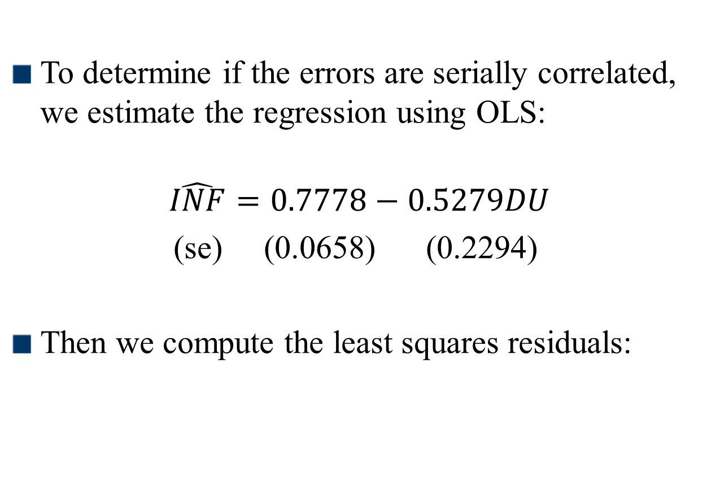
Serial Correlation
A Phillips Curve
To determine if the errors are serially correlated, we estimate the regression using OLS:
$$\hat{INF}=0.7778−0.5279DU$$
(se) (0.0658) (0.2294)
Then we compute the least squares residuals:

Slide 41
Serial Correlation
The Correlagram
The correlogram, also called the sample autocorrelation function, is the sequence of autocorrelations r₁, r₂, r₃, …
It shows the correlation between residuals that are one period apart, two periods apart, three periods apart, and so on…

Slide 42
Serial Correlation
Computing Autocorrelation
How do we test whether an autocorrelation is significantly different from zero?
The null hypothesis is H₀: ρ_{k} = 0
Using the correlogram we find that correlations at lags one through five are all significantly different from zero at 5% significance level.

Slide 43
Estimation with Serially Correlated Errors

Slide 44
Estimation with Serially Correlated Errors
Least Squares
Estimation
Suppose we proceed with least squares estimation without recognizing the existence of serially correlated errors. What are the consequences?
The least squares estimator is still a linear unbiased and consistent estimator, but it is no longer best
The formulas for the standard errors usually computed for the least squares estimator are no longer correct
Confidence intervals and hypothesis tests that use these standard errors will be misleading

Slide 45
Autoregressive Distributed Lag Models

Slide 46
Estimation with Serially Correlated Errors
Suppose we want to estimate:
with -1 < ρ < 1
For the v_{t}, we have:

Slide 47
Estimation with Serially Correlated Errors
With the appropriate substitutions, we get:
For the previous period, the error is:
Multiplying by ρ:

Slide 48
Estimation with Serially Correlated Errors
ARDL models
Substituting we get:
Denote:
We get:
By adding lags of x and y to the model, we have eliminated the serial correlation. We can estimate the transformed model using OLS, and the estimates are BLUE!

Slide 49
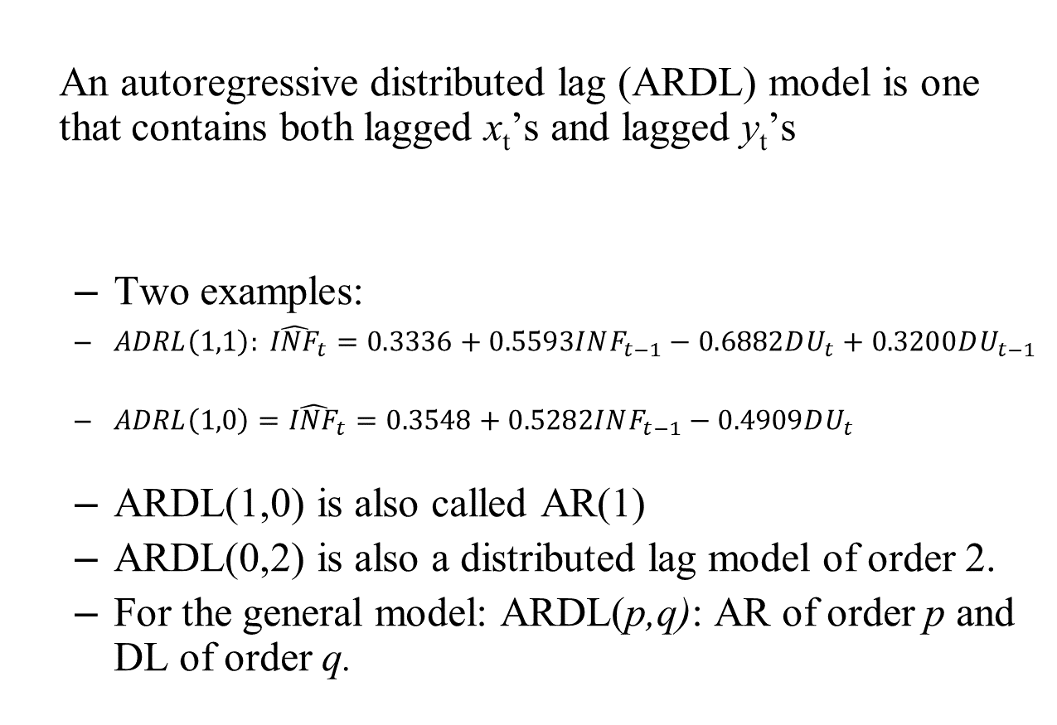
Autoregressive Distributed Lag Models
An autoregressive distributed lag (ARDL) model is one that contains both lagged x_{t}’s and lagged y_{t}’s
Two examples:
$ADRL\left(1,1\right): {\hat{INF}}_{t}=0.3336+0.5593INF_{t−1}−0.6882DU_{t}+0.3200DU_{t−1}$
$ADRL\left(1,0\right)={\hat{INF}}_{t}=0.3548+0.5282INF_{t−1}−0.4909DU_{t}$
ARDL(1,0) is also called AR(1)
ARDL(0,2) is also a distributed lag model of order 2.
For the general model: ARDL(p,q): AR of order p and DL of order q.

Slide 50
Choosing The Correct ARDL Model

Slide 51
Autoregressive Distributed Lag Models
Four possible criteria for choosing p (order of AR) and q (order of distributed lag):
Has serial correlation in the errors been eliminated?
Are the signs and magnitudes of the estimates consistent with our expectations from economic theory?
Are the estimates significantly different from zero, particularly those at the longest lags?
What values for p and q minimize information criteria such as the AIC and SC?

Slide 52
Okun’s Law - Revisit
Autoregressive Distributed Lag Models
Okun’s Law
Earlier we suggested ARDL(0,2) for Okun’s Law.
Can we improve that model?

Slide 53
Autoregressive Distributed Lag Models
Okun’s Law
Correlogram test suggests serial correlation of order 1 with ARDL(0,2) model.
We add to eliminate serial correlation
We confirm no serial correlation. However…
With ARDL(1,2), becomes insignificant.
We therefore estimate an ARDL(1,1) model
Estimates are all significant and no serial correlation.
ARDL(1,1) is confirmed by both AIC and SC criteria.

Slide 54
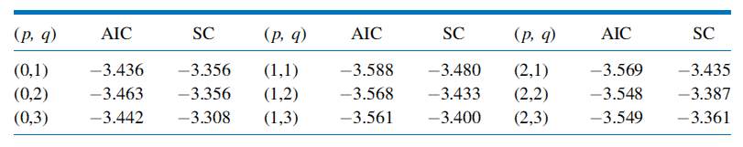
Autoregressive Distributed Lag Models
AIC and SC Values for Okun’s Law ARDL Models
Okun’s Law

Slide 55
Newey-West Standard Errors

Slide 56
Estimation with Serially Correlated Errors
HAC standard errors
It is possible to compute correct standard errors for the least squares estimator:
HAC (heteroskedasticity and autocorrelation consistent) standard errors, or Newey-West standard errors.

Slide 57
Estimation with Serially Correlated Errors
HAC standard errors
However, this approach has serious limitations:
With serial correlation, LS estimator is inefficient: HAC SE are relatively large.
We lose the dynamic interpretation of our estimates!

